Slide 1

ANDROID MOBILE APP COMPANION FOR UNIVERSITY STUDENT
CHING MING SIEW
1401239

Slide 2
Outline
CHAPTER 1 INTRODUCTION
CHAPTER 2 LITERATURE REVIEW
CHAPTER 3 METHODOLOGY AND WORK PLAN
CHAPTER 4 PROJECT INITIAL SPECIFICATION
CHAPTER 5 SYSTEM DESIGN
CHAPTER 6 SYSTEM TESTING
CHAPTER 7 CONCLUSIONS AND RECOMMENDATIONS

Slide 3
CHAPTER 1 INTRODUCTION

Slide 4
CHAPTER 1 INTRODUCTION
Problem Statement
Project Objectives
Main features of the Project

Slide 5
Problem Statement
Students are poor in managing their time.
Students are poor in managing their pocket money.
Similar market application does not offer full package function.

Slide 6
Project Objective
To develop an application that manages students’ time and improves their time management skill.
To develop an application that manages student’s study material.
To develop an application that reduces student overspending problem.
To develop an application that combines useful function from various application into one application to bring convenience services to student.

Slide 7
Main features of the Project
Event reminder feature
Timetable feature
Study material storing feature
Feedback to UTAR feature
Expenditure planning feature

Slide 8
CHAPTER 2 LITERATURE REVIEW

Slide 9
CHAPTER 2 LITERATURE REVIEW
Methodology Comparison
Application Type Comparison

Slide 10
Methodology Comparison
Agile
Waterfall

Slide 11
Agile vs Waterfall
Waterfall is a mush stricter, rigid process.
Agile is flexible and continuously evolving.
Waterfall is a structured process.
Waterfall is sequential and Agile does not enforce a linear process.
In Waterfall projects, you can’t change things that were done in previous stages.
Agile is very accommodating to changes.
Notes:
The differences between Waterfall methodology versus Agile can be summed up
Waterfall is a mush stricter, rigid process.
Agile is flexible and continuously evolving.
Waterfall is a structured process where you can’t start on a new phase until the previous one has been completed.
Agile is a flexible process, allowing you to move through the project as you like.
Waterfall is sequential and Agile does not enforce a linear process.
In Waterfall projects, you can’t change things that were done in previous stages, whereas Agile is very accommodating to changes.

Slide 12
Waterfall is recommended if:
You don’t expect changes in scope.
The project is very simple or you’ve done it many times before.
Requirements are very well known and fixed.
Customers know exactly what they want in advance.
You’re working with orderly and predictable projects.
Notes:
You don’t expect changes in scope.
The project is very simple or you’ve done it many times before
Requirements are very well known and fixed
Customers know exactly what they want in advance
You’re working with orderly and predictable projects

Slide 13
Agile is recommended if:
The final product isn’t clearly defined.
The clients/stakeholders need the ability to modify the scope.
You anticipate any kind of changes during the project.
Rapid deployment is the goal.
Notes:
The final product isn’t clearly defined.
The clients/stakeholders need the ability to modify the scope.
You anticipate any kind of changes during the project.
Rapid deployment is the goal.

Slide 14
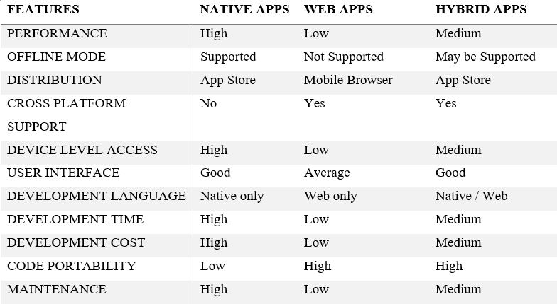
Application Type Comparison

Slide 15
CHAPTER 3 METHODOLOGY AND WORK PLAN

Slide 16
CHAPTER 3 METHODOLOGY AND WORK PLAN
Project Methodology

Slide 17
Project Methodology
Agile methodology will be use in this project.
Due to some uncertainty of project, a methodology that embrace changes is needed.
Notes:
Agile methodology will be use in this project.
Because there are still many uncertainty in this project
For example, like can timetable feature is something I never encounter before, can I do it or not.
Therefore Agile is more suitable in my Final Year Project.

Slide 18
CHAPTER 4 PROJECT SPECIFICATION

Slide 19
CHAPTER 5 SYSTEM DESIGN

Slide 20
CHAPTER 5 SYSTEM DESIGN
Use Case Diagram
Data Flow Diagram

Slide 21
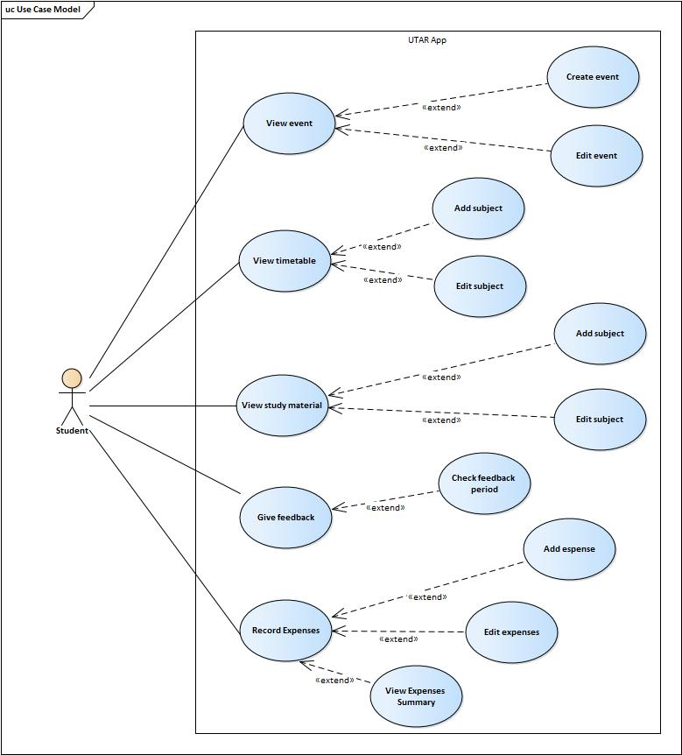

Slide 22
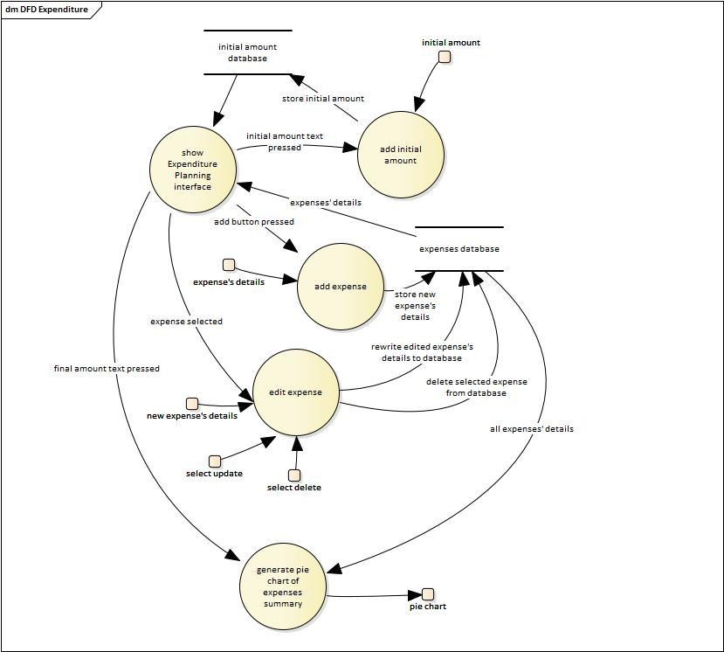

Slide 23
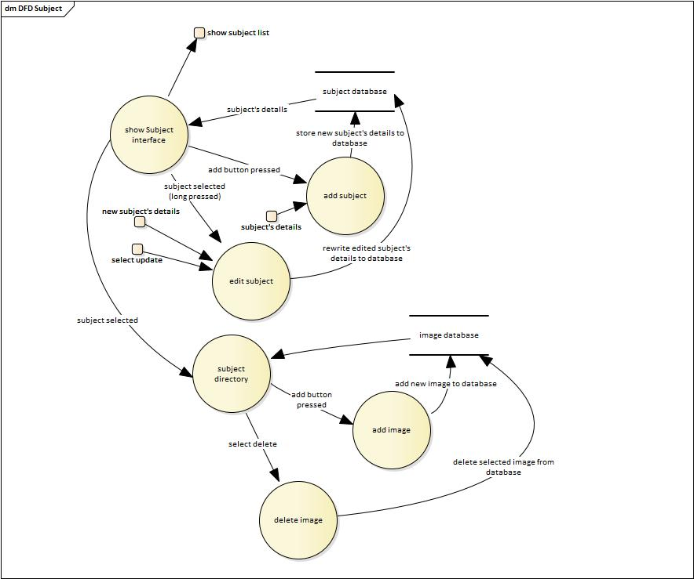

Slide 24
CHAPTER 6 SYSTEM TESTING

Slide 25
CHAPTER 6 SYSTEM TESTING
Interface Testing
Integration Testing
System Testing
User Acceptance Testing

Slide 26
User Acceptance Testing
Evaluation Form result summary
Description | Average Rating
I found the system’s interface (buttons, dialog, icons) and easy way to performing system functions. | 4.7
I felts the system responded in a consistent and predictable way. | 4.5
Information was easy to find. | 4.3
Feedback given by the system was proper and sufficient. | 3.4
I would like to use this system in real life. | 4.5
Notes:
This User Acceptance Testing result shown that this application is easy to use.
Most of the tester can complete all given task in short period of time.
Some of the tester I consider them failed on some test cases due to they used too long to complete certain task.
In Evaluation Form result shown that tester prefer more feedback is provided from this application such as when user press Add Button, will pop up feedback such as “Class Added”, same goes to update and delete.

Slide 27
CHAPTER 7 CONCLUSION AND RECOMMENDATIONS

Slide 28
CONCLUSIONS
Android Studio is a solid system to use for Android application development.
Comparing with React Native, Android Studio supports more component such as
Bottom Navigation Bar,
Tab Layout,
Date Picker,
Time Picker,
Floating Action Button and etc.
I tried to build my Final Year Project with React Native but it does not goes well.
Notes:
I never learnt React Native and I try to self learn.
Encounter many errors which I cannot resolve.
Comparing to Android Studio, information of React Native on the internet I can get is relatively less.

Slide 29
RECOMMENDATIONS
The Strength of using React Native as mobile development tools is cross-platform application building feature.
If developers who use Android Studio to build application and they want to cross-platform, they need to build everything from scratch.
Don’t use unfamiliar software on especially those projects with time limit.
Notes:
React Native can build applications on a platform, then convert it into another platform which much lesser effort compare to Android Studio.

Slide 30
Thank You

